Slide 1

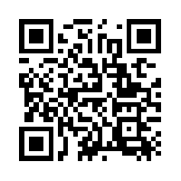
Quantum Communications Group
KML - base system overview
Group Coordinator:
Armando Nolasco Pinto
anp@ua.pt
Group Websites:
Diogo Matos
https://www.it.pt/Groups/Index/72
LinkedIn: https://www.linkedin.com/company/quantum-communications-group-it-av/

Slide 2
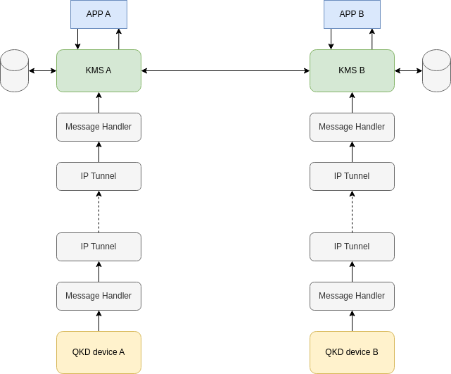
Architecture

Slide 3
QKD Device

Slide 4
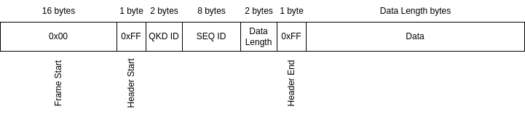
QKD frame
It generates keys and provides them to the KMS. We are mainly focused on the use of oblivious keys, but each KMS can be connected to symmetric QKD key providers and quantum RNG.
Frame structure of the data send to the KMS

Slide 5
KMS - modules

Slide 6
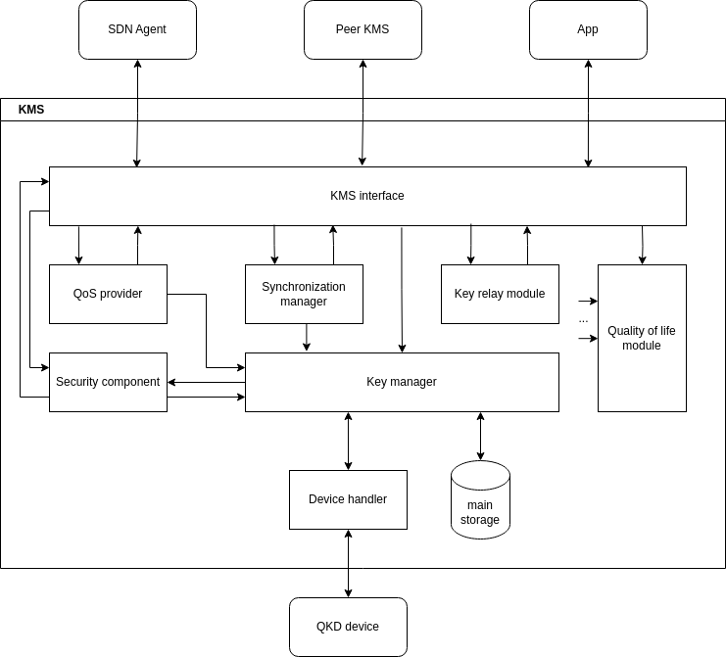

Slide 7
KMS - Key Synchronization and storage

Slide 8
Key synchronization
In order to make sure both apps connected to peer KMSs can receive matching keys (not necessarily identical), keys need to be synchronized between peer KMSs.
key_sync message example:
{‘header’:{
‘srcId’: ‘kms-xpto’,
‘type’: ‘key_sync’,
‘seq’: 2
},
‘data’:{
‘received_seqs’: [4,5,6,7]
}
}
Each KMS sends to its peer a key_sync message, notifying of the keys (seqs) received since the last message of the same type.
This message is send on a given period of number of received QKD frames. This period should be customizable for each KMS based on its key rate.
Notes:
chave está síncrona quando um dado kms enviou e recebeu uma mensagem do tipo key_sync com o seq respectivo à chave

Slide 9
Key storage
Each time a new QKD_frame is received by a KMS an action will be performed based on the following criteria:
current seq was mentioned in a key_sync message sent by the peer KMS, and by itself:
action: store keys with sync field at 1 (true)
current seq was not mentioned by in peer KMS’s key_sync messages and the last notified seq is higher than the current seq:
action: discard keys
default:
action: store keys with sync field at 0 (false)
The seq field might be updated based on the received key_sync messages. Unsynced keys are discarded after a given time period.

Slide 10
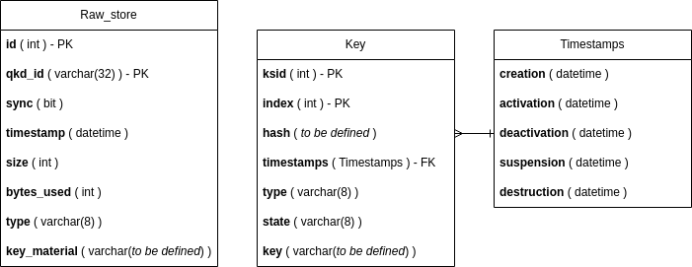
Key storage - DB tables

Slide 11
DB
The use of tools such as SPs, UDFs, triggers in the DB are crucial both for its security and performance.
Both Raw_store and Key table will grow rapidly, the use of indexes and/or the creation of additional tables might be needed in order to improve search performance.
DB maintenance - scheduled events:
delete old not synced raw keys (time period to be defined)
update key life cycle state (Key lifecycle monitoring)

Slide 12
KMS - Key provisioning

Slide 13
Message types
Source | Destination | ID | Description
APP | KMS | OPEN_CONNECT | App connect to KMS requesting the opening of a key stream
APP | KMS | GET_KEY | Request key material
APP | KMS | CLOSE | Close key stream
KMS | KMS | NEW_APP | Notify a new connection
KMS | KMS | NEW_KEY | Notify and request new key creation (bond a given ksid) and authentication
KMS | KMS | KEY_SYNC | Notify the peer of the latest keys received from the QKD device
* | * | ACK | Acknowledge previous message

Slide 14
Key Manager module
Direct oblivious or symmetric keys
Check for unused created keys. If there’s any, select the on with the lower index and jump to point 4.
Query DB for the oldest oblivious (or symmetric) raw key with a given size. DB creates the key and returns its index.
Notify peer of the creation of the key (NEW_KEY) and wait for the ACK
Return key with respective metadata
Symmetric keys based on oblivious keys
Check for unused created keys. If there’s any, select the on with the lower index and jump to point 5.
Query DB for the oldest oblivious key with twice the size of the wished symmetric key. DB returns the actual key.
Notify peer of the creation of the key (NEW_KEY) and wait for the ACK
Generate and store new key
Return key with respective metadata

Slide 15
